Slide 1



15 Regional Energy Information in High Resolution
Shutterstock _732678970

Slide 2
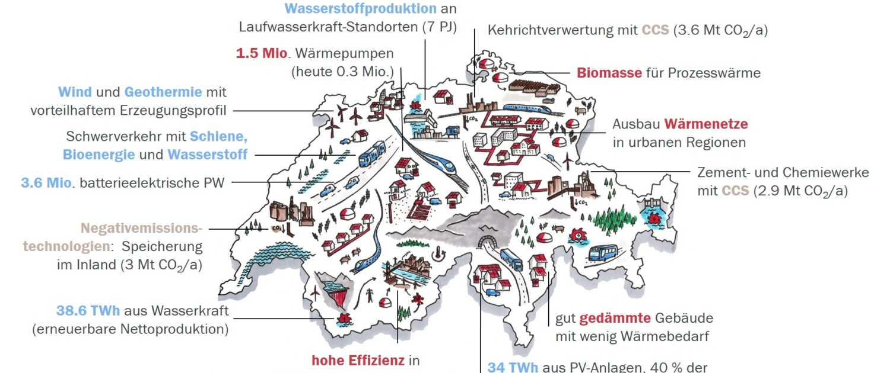
Context and guiding questions
National energy policy goals are known and monitored, but how is the progress of the Swiss energy transition on regional level?
Working on our challenges will contributing to the current, highly relevant discussion on security of energy supply in Switzerland. You will support us to develop cutting-edge energy policy design.
Outcomes will shed light into:
“Which municipalities have already set energy policy goals”, and,
“Which are typical activities of municipalities for contributing to the energy transition ”?

Slide 3
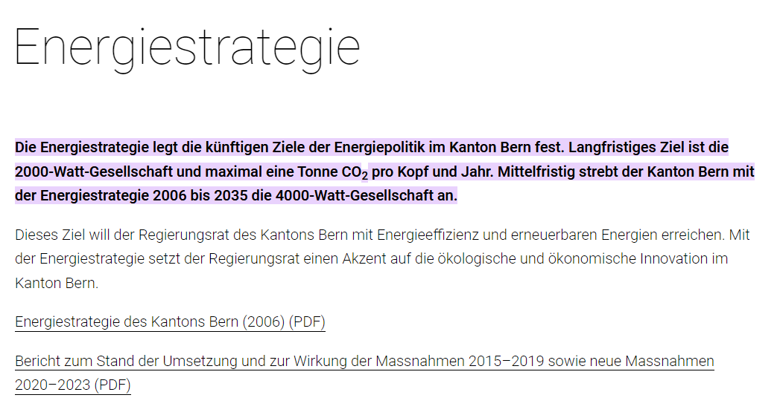

Challenge: Web scraping energy policy goals
Find and gather information about energy policy goals and activities of municipalities.
Identify ambitious and less ambitious municipalities
Optional: Cluster municipalities that follow same/close goals and benchmark

Slide 4
If you are...
a data scientist
or
have knowledge in NLP and Web-scrapping
or
are interested in energy policy
or
have bright ideas and want to push the energy transformation
or
are curious and a team player
...then join challenge
15

